Slide 1
Glass Recycling in Today’s Market
Scott DeFife
President
Glass Packaging Institute (GPI)
Glass Recycling Foundation
sdefife@gpi.org

Slide 2
Glass Container Industry – 2020 Operations
Food & Beverage Packaging Supply Chain Essential - CISA Guidance Ensures States Aligned
Waste Management & Recycling Deemed Essential during COVID
Early in Crisis Record Consumer Demand Shifts to Grocery Staples & All Bev Categories; levelled-off in Q2
Recycled content supply challenge due to On-premise closures; Bottle-bill enforcement suspension; MRF / Hauler operational changes for health of workforce
Educational Opportunity - Remind public on the link between cullet supply & new container production; Pilot innovative recovery options

Slide 3
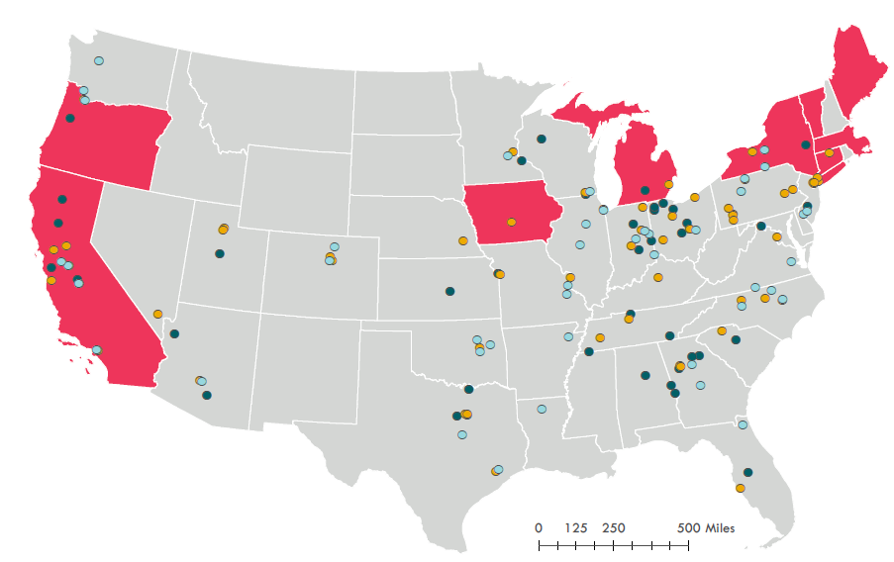
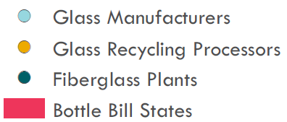
US Glass Infrastructure

Slide 4
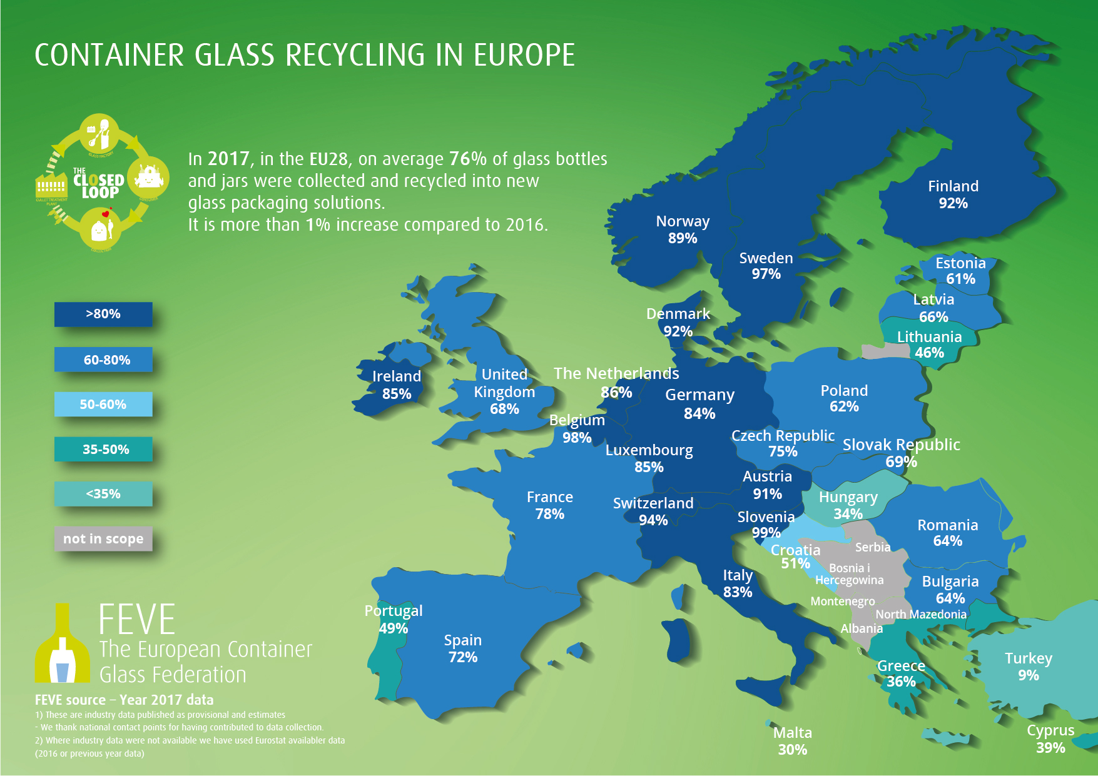
US Glass Recycling Expansion – What is Possible?
According to the EPA Glass recycling peaked in 2015; held steady since.
EU captures 2x+ % glass than US; fundamental differences in recovery/ deposit systems
Uncollected On-premise glass = 50% more than all deposit state glass
Industry studying ways to drive US Average to 50%
Notes:
According to the EPA Glass recycling peaked in 2015 and has fallen over the last 3 years.
As the percentage of glass recycled in Spain and the UK, for example, has doubled and tripled in the past 25 years, respectively, the numbers in the US have barely budged.
Lower Commodity Values focuses on negative value of glass
National Sword and China Ban impact on paper and mixed plastic- worth 65% less than 5-year average in 2016
Lower oil, gas, and consequent resin pricing
Metal Tariffs and lower priced foreign aluminum imports of UBC
Regulatory structure for curbside collection make it opt in practice in most cases
Low tip fees and little Regulation outside deposit states
Capture in Single Stream spotty, major areas and rural areas (i.e. Eastern Washington, Idaho, West Texas) have no reliable markets and/or processors
With the fall in commodity values, glass negative value at MRFs make them a target for removal
Cities and haulers looking to cut costs push on glass removal- like a virus moving through a population
Contractual strategies include Opt-in and Opt-out pricing, higher tip fees, exceptions to bidding taking out glass

Slide 6
Material Flow Across the Value Chain – Non-Redemption States
RRS 2016 data

Slide 7
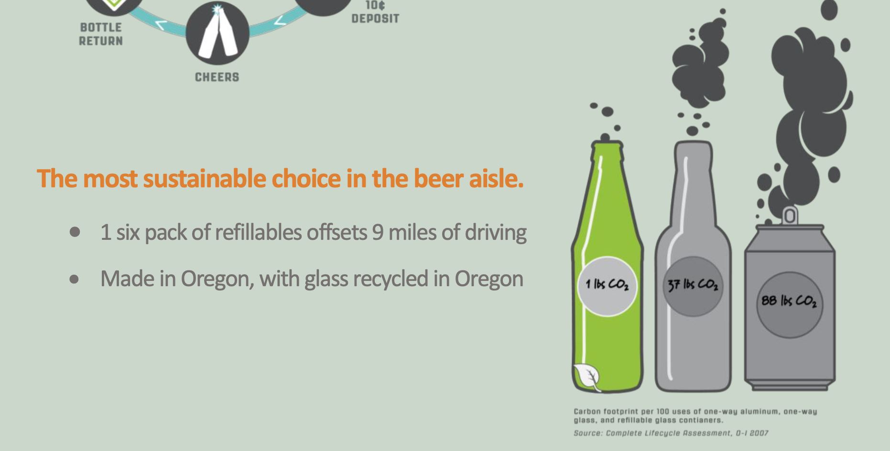
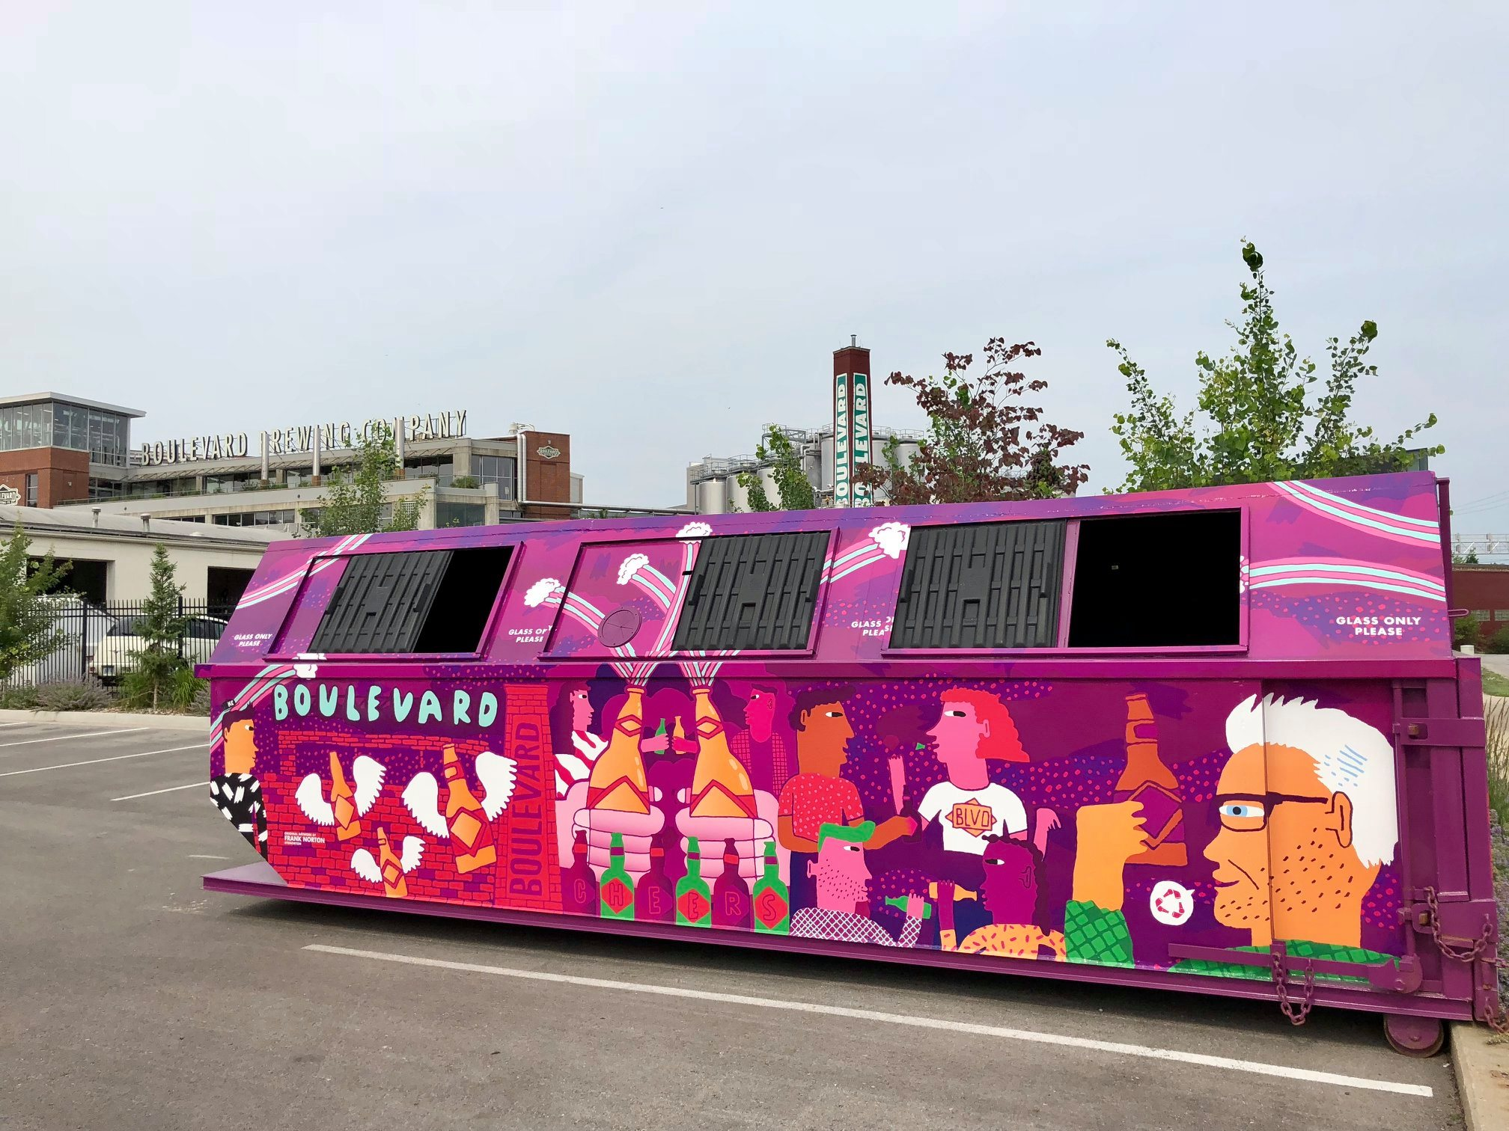
Alternative Solutions
Refillables and Re-usable Programs Growing
OBRC Craft Refillables
Dairy Refillable Growth
Glass Drop-offs Work Where MRFs Don’t or Won’t
Single-Stream only as good as the target facility
Municipal contract power is limited in many regions
Many MRFs incented to landfill glass
Haulers and Landfill companies Lie about Glass
Volume vs Quality / Really an Issue of Yield
Drop-off Quality High, Flexible Siting
Great for Partnerships and Educating Consumers

