Slide 1
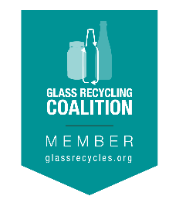
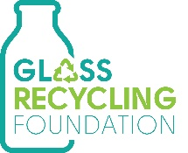
Recycling glass with alternative collections
Proud Members of:
Laura Hennemann | VP, Marketing & Communications
Strategic Materials – NA’s Largest Glass Recycler

Slide 2
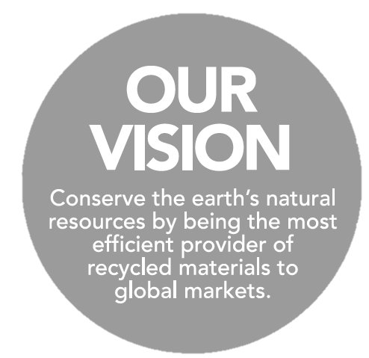
Our footprint
Largest glass recycler in North America, recycling nearly 3 million tons per year with over 120 years of experience.

Slide 3
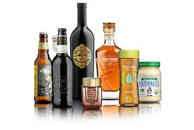
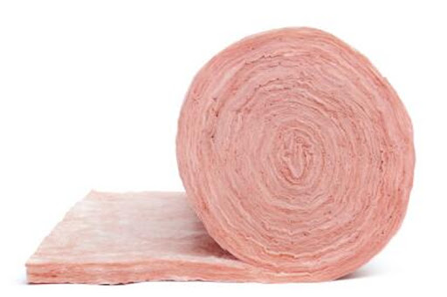
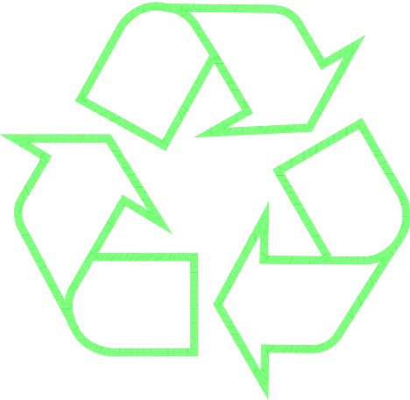
Where does glass go? Why is it important?
DID YOU KNOW?
Glass accounts for up to 25% of your recycling bin?
100% recyclable, endlessly, with virtually no loss
Recycled glass displaces virgin materials by up to 95%
Recycled glass melts at a lower temperature
2-3% energy reduction for every 10% of recycled glass used
1 ton of CO₂ is reduced for every 6 tons of recycled glass
Extends furnace life for container manufacturers
Energy Star®, LEED® eligibility - fiberglass & building materials
Strength properties / pozzolanic characteristics
Consumer considerations – chemically inert, ocean-friendly, recyclable/sustainable
High value markets:
Glass containers, fiberglass insulation
Fillers for carpet, terrazzo, tiles, countertop, concrete
Light-weight aggregate
Low-value markets: (less desirable)
Road base aggregate
Landfill cover
Sources: Glass Packaging Institute; Glass Recycling Coalition, North America Insulation Manufacturers Institute (NAIMA)
Notes:
We focus on high value markets because glass is expensive to recycle due to contamination and logistics. It also allows for glass’s product lifecycle to continue. What does that mean? A circular economy.

Slide 4
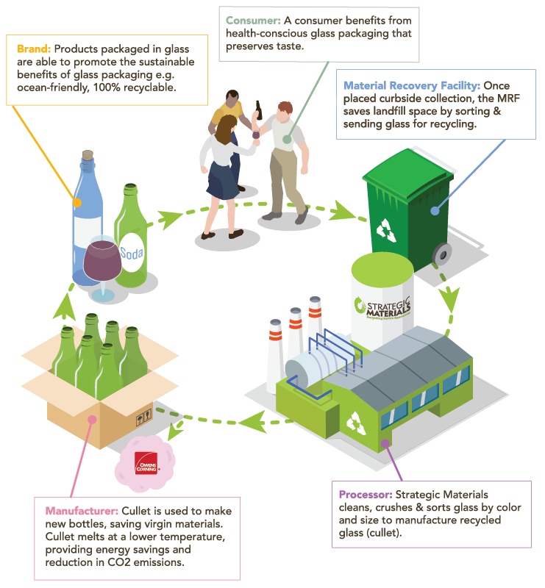
The circular economy of glass

Slide 5
Debunking myths
What have you heard about glass?
CLAIM
FACT
Broken glass cannot be accepted
We accept broken glass
Mixed color glass cannot be accepted
We accept mixed color glass
Glass must be washed & cleaned
Labels & organics clinging to glass present no problem
Glass contaminates other recyclables
Single-stream contaminates every material in the bin. Proper layout, sequence & processing at the MRF maximizes value for all streams
Glass cannot be recycled due to China’s SWORD policy
This is not true. Glass is produced and recycled domestically
Glass has no value and belongs in the landfill, or the value of glass has gone down
Glass has value and can be maximized with proper process or equipment. Glass value is variable. The amount of garbage has increased, which hurts glass value
There are no end markets for glass
End markets include container, fiberglass insulation, highway bead & more. Demand exceeds supply in many areas

Slide 6
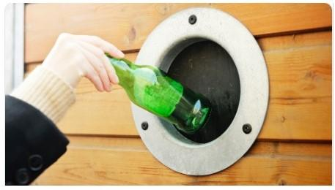
COVID Impacts
Glass packaging products considered “essential”
Increased demand for glass packaged grocery & beverage products
Increased demand for medical glass
Reduced supply in deposit states
Reduced supply from bars, restaurants, casinos, sporting events
Slowly seeing bounce back for inbound supply.
Notes:
We focus on high value markets because glass is expensive to recycle due to contamination and logistics. It also allows for glass’s product lifecycle to continue. What does that mean? A circular economy.

Slide 7
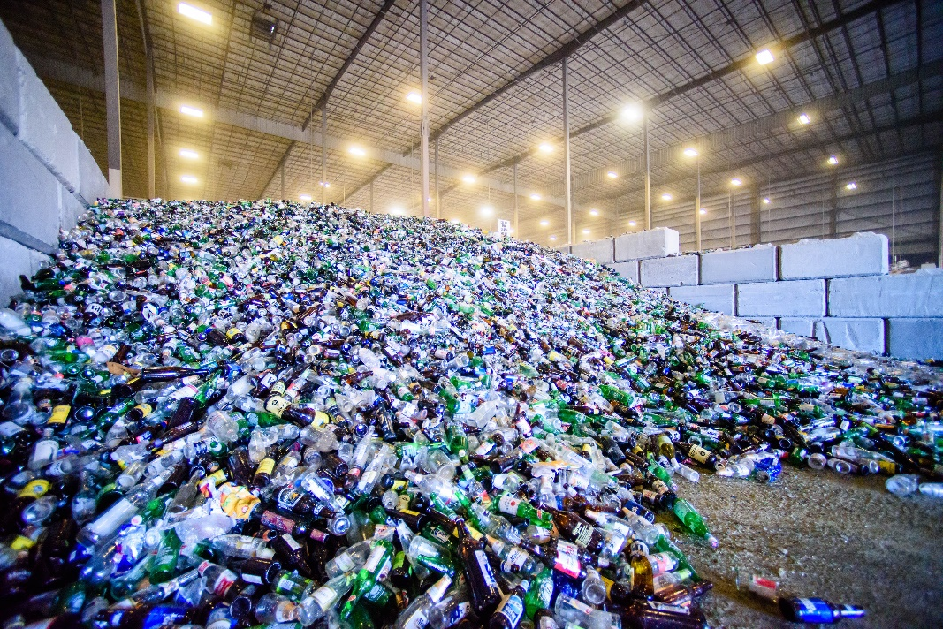
Thank You
Laura Hennemann Vice President, Marketing & Communications lhennemann@strategicmaterials.com
info@strategicmaterials.com
Photo courtesy of Strategic Materials, Inc.

